Slide 1
Westbury Sub Mendip Neighbourhood Plan Questionnaire
Wednesday, May 29, 2024

Slide 2
142
Total Responses
Date Created: Thursday, April 18, 2024
Complete Responses: 142

Slide 3
Q1: For each of the following, please tick the box which you think best describes the current provision in the Parish:
Answered: 139 Skipped: 3

Slide 4
Q1: For each of the following, please tick the box which you think best describes the current provision in the Parish:
Answered: 139 Skipped: 3
 | EXCELLENT | GOOD | FAIR | POOR | VERY POOR | TOTAL | WEIGHTED AVERAGE
Community events and activities | 29.50% 41 | 53.96% 75 | 15.83% 22 | 0.72% 1 | 0% 0 | 139 | 1.88
Leisure spaces and opportunities | 2.92% 4 | 48.91% 67 | 37.96% 52 | 10.22% 14 | 0% 0 | 137 | 2.55
Facilities and services provision | 2.19% 3 | 38.69% 53 | 47.45% 65 | 10.95% 15 | 0.73% 1 | 137 | 2.69
Housing range and choice | 3.65% 5 | 24.09% 33 | 49.64% 68 | 20.44% 28 | 2.19% 3 | 137 | 2.93
Local job opportunities | 1.47% 2 | 8.09% 11 | 40.44% 55 | 41.18% 56 | 8.82% 12 | 136 | 3.48

Slide 5
Q2: As a community what should we focus on to become more sustainable? Please tick those that you consider are most important. Tick up to five.
Answered: 140 Skipped: 2

Slide 6
Q2: As a community what should we focus on to become more sustainable? Please tick those that you consider are most important. Tick up to five.
Answered: 140 Skipped: 2
ANSWER CHOICES | RESPONSES
Improve public transport | 72.86% | 102
Traffic management and control | 57.86% | 81
Promote wildlife areas | 52.86% | 74
Renewable energy | 50.0% | 70
Improve drainage | 48.57% | 68
Improve rights of way and footpaths | 47.14% | 66
Local design code for buildings and extensions | 45.00% | 63
More dedicated cycle-routes | 37.14% | 52
More recycling opportunities | 21.43% | 30
Reduce car use and increase car-sharing | 8.57% | 12
TOTAL |  | 618

Slide 7
Q3: In your opinion, how strong is the sense of community in the Parish? (tick one)
Answered: 141 Skipped: 1

Slide 8
Q3: In your opinion, how strong is the sense of community in the Parish? (tick one)
Answered: 141 Skipped: 1
ANSWER CHOICES | RESPONSES
Strong | 38.30% | 54
Quite Strong | 44.68% | 63
Average | 14.18% | 20
Weak | 2.84% | 4
TOTAL |  | 141

Slide 9
Q4: Housing DevelopmentWestbury Sub Mendip has 353 dwellings; please indicate what level of housing growth you would like to see over the next 15 years?
Answered: 135 Skipped: 7

Slide 10
Q4: Housing DevelopmentWestbury Sub Mendip has 353 dwellings; please indicate what level of housing growth you would like to see over the next 15 years?
Answered: 135 Skipped: 7
ANSWER CHOICES | RESPONSES
fewer than 20 dwellings | 33.33% | 45
20--50 dwellings | 54.81% | 74
51-75 dwellings | 8.89% | 12
more than 75 | 2.96% | 4
TOTAL |  | 135

Slide 11
Q5: Do you think the services below need improving to satisfy the future needs of the Parish?
Answered: 134 Skipped: 8

Slide 12
Q5: Do you think the services below need improving to satisfy the future needs of the Parish?
Answered: 134 Skipped: 8
 | YES | NO | MAYBE | TOTAL | WEIGHTED AVERAGE
Surface water drainage | 75.94% 101 | 8.27% 11 | 15.79% 21 | 133 | 1.40
Sewage system | 47.29% 61 | 16.28% 21 | 36.43% 47 | 129 | 1.89
Electricity | 27.64% 34 | 33.33% 41 | 39.02% 48 | 123 | 2.11
Mains Gas | 19.51% 24 | 39.84% 49 | 40.65% 50 | 123 | 2.21
Broadband | 46.40% 58 | 30.40% 38 | 23.20% 29 | 125 | 1.77
Mains Water | 23.14% 28 | 36.36% 44 | 40.50% 49 | 121 | 2.17
Mobile phone network | 66.93% 85 | 15.75% 20 | 17.32% 22 | 127 | 1.50

Slide 13
Q6: Settlement CharacterHow important is it that the following characteristics of the conservation area of Westbury Sub Mendip are safeguarded and reflected in new development? (Conservation area is on the whole the older part of the village including the open spaces)
Answered: 136 Skipped: 6

Slide 14
Q6: Settlement CharacterHow important is it that the following characteristics of the conservation area of Westbury Sub Mendip are safeguarded and reflected in new development? (Conservation area is on the whole the older part of the village including the open spaces)
Answered: 136 Skipped: 6
 | VERY IMPORTANT | MODERATELY IMPORTANT | NOT IMPORTANT | TOTAL | WEIGHTED AVERAGE
The character and layout of existing buildings in the village | 71.85% 97 | 25.93% 35 | 2.22% 3 | 135 | 1.30
The “green natural wedges” within the built environment | 73.13% 98 | 21.64% 29 | 5.22% 7 | 134 | 1.32
Views from the Village: Both panoramic and glimpsed views of the countryside and landmark buildings | 72.79% 99 | 20.59% 28 | 6.62% 9 | 136 | 1.34
Building styles, types, and materials | 69.40% 93 | 26.87% 36 | 3.73% 5 | 134 | 1.34
Stonewalls and hedge boundary style | 64.18% 86 | 26.12% 35 | 9.70% 13 | 134 | 1.46
The presence of front gardens | 33.09% 45 | 43.38% 59 | 23.53% 32 | 136 | 1.90
Narrow lanes without pavements | 23.48% 31 | 40.15% 53 | 36.36% 48 | 132 | 2.13

Slide 15
Q7: Are there other physical ‘features’ in the Parish not mentioned in question 6, that are important to retain?
Answered: 127 Skipped: 15

Slide 16
Q7: Are there other physical ‘features’ in the Parish not mentioned in question 6, that are important to retain?
Answered: 127 Skipped: 15
ANSWER CHOICES | RESPONSES
Yes | 33.07% | 42
No | 29.92% | 38
Unsure | 37.01% | 47
TOTAL |  | 127

Slide 17
Q11: Environment and EcologyHow important are the following to the setting of the village and character of the area?
Answered: 136 Skipped: 6

Slide 18
Q11: Environment and EcologyHow important are the following to the setting of the village and character of the area?
Answered: 136 Skipped: 6
 | VERY IMPORTANT | MODERATELY IMPORTANT | NOT IMPORTANT | TOTAL | WEIGHTED AVERAGE
The presence of woodlands and mature trees | 84.44% 114 | 14.81% 20 | 0.74% 1 | 135 | 1.16
The variety of wildlife | 80.74% 109 | 18.52% 25 | 0.74% 1 | 135 | 1.2
Green open spaces | 82.22% 111 | 14.07% 19 | 3.70% 5 | 135 | 1.21
Farming activity and livestock | 80.74% 109 | 14.81% 20 | 4.44% 6 | 135 | 1.24
Boundary treatment of dry-stone walls and hedges | 71.85% 97 | 25.19% 34 | 2.96% 4 | 135 | 1.31
The dark skies | 64.44% 87 | 22.22% 30 | 13.33% 18 | 135 | 1.49
The presence of front gardens | 27.41% 37 | 55.56% 75 | 17.04% 23 | 135 | 1.90

Slide 19
Q12: How do you rate the provision for public access to the countryside?
Answered: 134 Skipped: 8

Slide 20
Q12: How do you rate the provision for public access to the countryside?
Answered: 134 Skipped: 8
 | GOOD | FAIR | POOR | TOTAL | WEIGHTED AVERAGE
Country lanes | 58.78% 77 | 39.69% 52 | 1.53% 2 | 131 | 1.43
Footpaths | 58.78% 77 | 36.64% 48 | 4.58% 6 | 131 | 1.46
Multi user paths | 53.03% 70 | 42.42% 56 | 4.55% 6 | 132 | 1.52
Open access | 42.86% 54 | 42.86% 54 | 14.29% 18 | 126 | 1.71
Bridleways | 36.29% 45 | 48.39% 60 | 15.32% 19 | 124 | 1.79

Slide 21
Q14: We can protect local green spaces within or close to the village because of their amenity or recreation value – do you have any suggestions about which ones we should protect and why
Answered: 126 Skipped: 16

Slide 22
Q14: We can protect local green spaces within or close to the village because of their amenity or recreation value – do you have any suggestions about which ones we should protect and why
Answered: 126 Skipped: 16
ANSWER CHOICES | RESPONSES
Yes | 50.79% | 64
No | 17.46% | 22
Unsure | 31.75% | 40
TOTAL |  | 126

Slide 23
Q16: In the area where you live, are you concerned about:
Answered: 135 Skipped: 7

Slide 24
Q16: In the area where you live, are you concerned about:
Answered: 135 Skipped: 7
 | YES | NO | NOT APPLICABLE | TOTAL | WEIGHTED AVERAGE
Drainage / surface water run-off | 70.68% 94 | 29.32% 39 | 0% 0 | 133 | 1.29
Light pollution | 39.39% 52 | 56.82% 75 | 3.79% 5 | 132 | 1.64
Traffic noise | 30.83% 41 | 65.41% 87 | 3.76% 5 | 133 | 1.73
Water quality | 26.72% 35 | 70.99% 93 | 2.29% 3 | 131 | 1.76
Air quality | 18.60% 24 | 79.07% 102 | 2.33% 3 | 129 | 1.84
Other noises (please describe) | 20.75% 22 | 64.15% 68 | 15.09% 16 | 106 | 1.94

Slide 25
Q17: Traffic and TransportThe Neighbourhood Plan is not able to include policies directly relating to highway management and maintenance but can affect pedestrian safety in the village and other user issues.Do any of the following traffic-related matters need addressing?
Answered: 133 Skipped: 9

Slide 26
Q17: Traffic and TransportThe Neighbourhood Plan is not able to include policies directly relating to highway management and maintenance but can affect pedestrian safety in the village and other user issues.Do any of the following traffic-related matters need addressing?
Answered: 133 Skipped: 9
 | YES | NO | UNSURE | TOTAL | WEIGHTED AVERAGE
Road maintenance | 87.79% 115 | 6.11% 8 | 6.11% 8 | 131 | 1.18
Footways in the village alongside the main road | 79.39% 104 | 18.32% 24 | 2.29% 3 | 131 | 1.23
Measures to improve pedestrian safety | 81.25% 104 | 12.50% 16 | 6.25% 8 | 128 | 1.25
Vehicle speeds through the village on the A371 | 77.10% 101 | 18.32% 24 | 4.58% 6 | 131 | 1.27
HGV traffic | 77.27% 102 | 13.64% 18 | 9.09% 12 | 132 | 1.32
Public parking in the village | 70.54% 91 | 19.38% 25 | 10.08% 13 | 129 | 1.40
Cycleways and routes | 52.38% 66 | 33.33% 42 | 14.29% 18 | 126 | 1.62
Vehicle speeds in the village other than on the A371 | 48.84% 63 | 39.53% 51 | 11.63% 15 | 129 | 1.63
Other traffic issues, please explain below | 31.87% 29 | 41.76% 38 | 26.37% 24 | 91 | 1.95
Other footways in the village | 16.39% 20 | 63.11% 77 | 20.49% 25 | 122 | 2.04

Slide 27
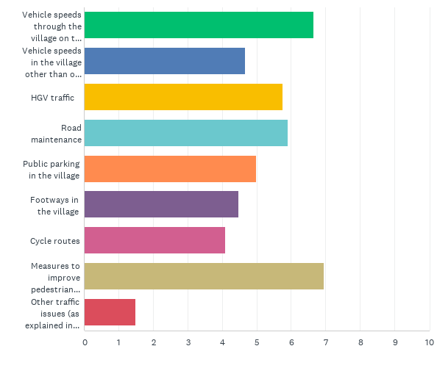
Q18: Please rank the following list in order of importance (with 1 being highest).(Either click and drag or use arrows to move rows)
Answered: 131 Skipped: 11

Slide 28
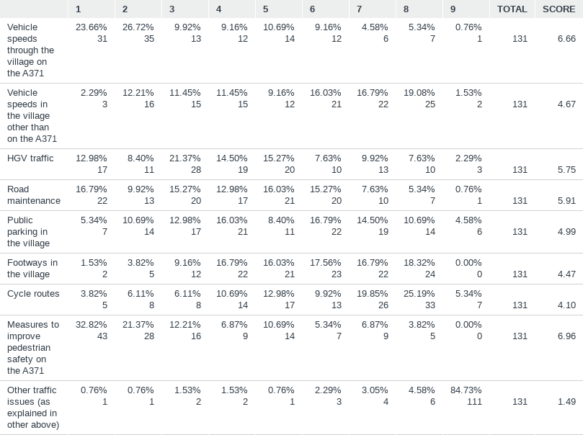
Q18: Please rank the following list in order of importance (with 1 being highest).(Either click and drag or use arrows to move rows)
Answered: 131 Skipped: 11

Slide 29
Q19: Is the No. 126 bus service crucial to the life and well-being of Westbury Sub Mendip?
Answered: 131 Skipped: 11

Slide 30
Q19: Is the No. 126 bus service crucial to the life and well-being of Westbury Sub Mendip?
Answered: 131 Skipped: 11
ANSWER CHOICES | RESPONSES
Yes | 90.84% | 119
No | 2.29% | 3
Unsure | 6.87% | 9
TOTAL |  | 131

Slide 31
Q20: How often do you use the buses to Wells / Cheddar / Westbury Sub Mendip?
Answered: 133 Skipped: 9

Slide 32
Q20: How often do you use the buses to Wells / Cheddar / Westbury Sub Mendip?
Answered: 133 Skipped: 9
ANSWER CHOICES | RESPONSES
Daily | 1.50% | 2
Weekly | 3.76% | 5
Monthly | 5.26% | 7
Occasionally | 56.39% | 75
Never | 34.59% | 46
TOTAL |  | 135

Slide 33
Q21: Would your use of the bus service change if there was a more frequent or convenient service?
Answered: 133 Skipped: 9

Slide 34
Q21: Would your use of the bus service change if there was a more frequent or convenient service?
Answered: 133 Skipped: 9
ANSWER CHOICES | RESPONSES
Yes | 45.11% | 60
No | 14.29% | 19
Maybe | 40.60% | 54
TOTAL |  | 133

Slide 35
Q24: Local Economy and TourismHow should we help provide for local jobs and support the local economy?
Answered: 131 Skipped: 11

Slide 36
Q24: Local Economy and TourismHow should we help provide for local jobs and support the local economy?
Answered: 131 Skipped: 11
 | YES | NO | UNSURE | TOTAL | WEIGHTED AVERAGE
Provide spaces for start-up businesses | 74.60% 94 | 6.35% 8 | 19.05% 24 | 126 | 1.44
Support the conversion of rural buildings | 66.93% 85 | 7.87% 10 | 25.20% 32 | 127 | 1.58
Support the extension of existing businesses | 67.46% 85 | 6.35% 8 | 26.19% 33 | 126 | 1.59
Protect existing employment sites from changes of use | 60.16% 77 | 10.94% 14 | 28.91% 37 | 128 | 1.69
Encourage home-working | 52.76% 67 | 17.32% 22 | 29.92% 38 | 127 | 1.77
Other, please detail | 15.38% 6 | 28.21% 11 | 56.41% 22 | 39 | 2.41

Slide 37
Q25: Should we ensure there is local provision and services for visitors and tourists by:
Answered: 134 Skipped: 8

Slide 38
Q25: Should we ensure there is local provision and services for visitors and tourists by:
Answered: 134 Skipped: 8
 | YES | NO | UNSURE | TOTAL | WEIGHTED AVERAGE
Safeguarding the Shop and Pub | 93.98% 125 | 0.75% 1 | 5.26% 7 | 133 | 1.11
Safeguarding existing tourism businesses | 80.16% 101 | 5.56% 7 | 14.29% 18 | 126 | 1.34
Supporting new tourism businesses | 65.62% 84 | 8.59% 11 | 25.78% 33 | 128 | 1.60
Providing better visitor information and signage | 60.16% 77 | 14.06% 18 | 25.78% 33 | 128 | 1.66

Slide 39
Q26: How important are the following in the life of the community:
Answered: 134 Skipped: 8

Slide 40
Q26: How important are the following in the life of the community:
Answered: 134 Skipped: 8
 | VERY IMPORTANT | IMPORTANT | SLIGHTLY IMPORTANT | NOT IMPORTANT | TOTAL | WEIGHTED AVERAGE
Community Shop | 88.72% 118 | 9.02% 12 | 2.26% 3 | 0% 0 | 133 | 1
Public Parking areas (The Square, Mortar Pits) | 60.31% 79 | 28.24% 37 | 9.16% 12 | 2.29% 3 | 131 | 1
Robert Glanville Playing Field | 70.45% 93 | 27.27% 36 | 2.27% 3 | 0% 0 | 132 | 1
St Lawrence Church | 52.63% 70 | 29.32% 39 | 10.53% 14 | 7.52% 10 | 133 | 1
St Lawrence School | 83.46% 111 | 15.04% 20 | 0.75% 1 | 0.75% 1 | 133 | 1
The Westbury Inn Pub | 70.45% 93 | 22.73% 30 | 6.06% 8 | 0.76% 1 | 132 | 1
Westbury Village Hall | 82.09% 110 | 14.93% 20 | 1.49% 2 | 1.49% 2 | 134 | 1

Slide 41
Q27: How do you rate the services, facilities and opportunities available for the following groups:
Answered: 129 Skipped: 13

Slide 42
Q27: How do you rate the services, facilities and opportunities available for the following groups:
Answered: 129 Skipped: 13
 | GOOD | FAIR | POOR | TOTAL | WEIGHTED AVERAGE
Children (0-10) | 30.0% 36 | 59.17% 71 | 10.83% 13 | 120 | 1.81
Young persons (11-17) | 4.17% 5 | 35.00% 42 | 60.83% 73 | 120 | 2.57
Young adults (18-30) | 2.50% 3 | 37.50% 45 | 60.0% 72 | 120 | 2.58
Parents and young families | 22.95% 28 | 68.03% 83 | 9.02% 11 | 122 | 1.86
Elderly people | 34.11% 44 | 51.16% 66 | 14.73% 19 | 129 | 1.81

Slide 43
Q29: Are you supportive of renewable energy installations being promoted and installed in the Parish?
Answered: 130 Skipped: 12

Slide 44
Q29: Are you supportive of renewable energy installations being promoted and installed in the Parish?
Answered: 130 Skipped: 12
ANSWER CHOICES | RESPONSES
Yes | 73.08% | 95
No | 7.69% | 10
Unsure | 19.23% | 25
TOTAL |  | 130

Slide 45
Q30: Do you think that the village should develop a community-based renewable energy project?
Answered: 130 Skipped: 12

Slide 46
Q30: Do you think that the village should develop a community-based renewable energy project?
Answered: 130 Skipped: 12
ANSWER CHOICES | RESPONSES
Yes | 46.92% | 61
No | 13.08% | 17
Unsure | 40.0% | 52
TOTAL |  | 130

Slide 47
Q33: Should we provide space for allotments and/or a community horticulture scheme?
Answered: 132 Skipped: 10

Slide 48
Q33: Should we provide space for allotments and/or a community horticulture scheme?
Answered: 132 Skipped: 10
ANSWER CHOICES | RESPONSES
Yes | 56.06% | 74
No | 16.67% | 22
Unsure | 27.27% | 36
TOTAL |  | 132

Slide 49
Q38: Please tell us your age group (tick one)
Answered: 133 Skipped: 9

Slide 50
Q38: Please tell us your age group (tick one)
Answered: 133 Skipped: 9
ANSWER CHOICES | RESPONSES
16-18 yrs | 1.50% | 2
18-24 yrs | 0.75% | 1
25-34 yrs | 1.50% | 2
35-44 yrs | 8.27% | 11
45-64 yrs | 33.83% | 45
65-79 yrs | 48.12% | 64
Over 80 yrs | 6.02% | 8
TOTAL |  | 133

Slide 51
Q39: Is your primary residence in the Parish of Westbury Sub Mendip?
Answered: 134 Skipped: 8

Slide 52
Q39: Is your primary residence in the Parish of Westbury Sub Mendip?
Answered: 134 Skipped: 8
ANSWER CHOICES | RESPONSES
Yes | 99.25% | 133
No | 0.75% | 1
TOTAL |  | 134

Slide 53
Q40: If NO, please indicate your relationship with the Parish:
Answered: 15 Skipped: 127

Slide 54
Q40: If NO, please indicate your relationship with the Parish:
Answered: 15 Skipped: 127
ANSWER CHOICES | RESPONSES
Land or Property Owner | 66.67% | 10
2nd Homeowner or Holiday-Let Owner | 0% | 0
Regular Visitor | 0% | 0
Work in the Area | 6.67% | 1
Other | 26.67% | 4
TOTAL |  | 15

Slide 55
Q41: Are you interested in helping prepare the Westbury Sub Mendip Neighbourhood Plan? By:
Answered: 112 Skipped: 30

Slide 56
Q41: Are you interested in helping prepare the Westbury Sub Mendip Neighbourhood Plan? By:
Answered: 112 Skipped: 30
ANSWER CHOICES | RESPONSES
Helping with events | 17.86% | 20
Delivering information | 28.57% | 32
Membership of task groups | 15.18% | 17
No thank you | 58.04% | 65
TOTAL |  | 134

