Slide 1
Future Village Facilities Preferences
Survey Results for discussion

Slide 2
Respondent profile

Slide 3
Part A - Possible Community Space on land south of Roughmoor Lane
If the land south of Roughmoor Lane was to be developed the policy requires that 0.1 hectares (20 x 50m (two tennis courts)) of land is allocated for community use by the village.
What should this community space be used for and where should it be located?

Slide 4
Part A Q2.
Please rank the top three most important village facilities you feel should be considered for locating in the greenfield area.

Slide 5
Numbers of times ranked as 1st, 2nd or 3rd

Slide 6
“Other”
Village pond
Community garden/ food forest area
a forest garden
Studio space/workshop for art works
Community orchard.
Adult gym equipment
A crop in the arable land space
Community orchard

Slide 7
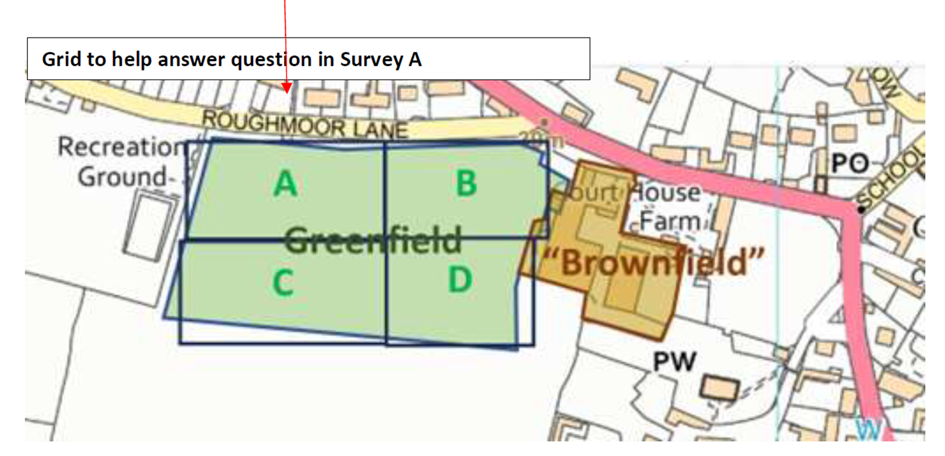
A3. Take your top three facilities ranked from Question A2 - where would the best location for this facility be (greenfield site only)

Slide 8
A3. Take your top three facilities ranked from Question A2 - where would the best location for this facility be (greenfield site only)

Slide 9
Comments (extracts)
“Shop and village hall would be best on brownfield site”
“Village Hall will provide changing rooms and toilets for all”
“A village hall as close to the heart of the village “
“playing fields can build their own toilets on the playing field itself “
“All depends on provision and placement of a safe crossing on the A371. “
“Having an opportunity for the community to discuss “
“Important that a new village hall has car parking attached. “
“Provision of parking would solve a problem with village centre. “
“New shop should be allocated in court farm court yard at the top”

Slide 10
Part B - Planning village facilities over the next 10-15 years
To contribute to a Neighbourhood Plan:
What facilities improvements we should we be planning for over the next 10-15 years and where should they be located.
Current facilities and potential new facilities

Slide 11
B2 Looking 10-15 years ahead how well suited are the current village shop and post office facilities ?

Slide 13
B6. Thinking about what additional facilities the village should be seeking to develop over the next 15 years. Please rank the following in order of priority with most important at the top.
Top 3 ranked positions only
1st 2nd 3rd
Numbers of times ranked as 1st, 2nd or 3rd

Slide 14
B7. Preferred locations - existing and potential facilities

Slide 15
General Comments
Brownfield site should be first priority
Any new hall to meet multiple purposes / for all. Currently underused.
Everything contingent on safe crossing of A371
Traffic Calming overdue
Challenges of visibility for crossing A371
Footpath linking Crow lane and Hannahs lane
Sort parking and concentrate on what village needs (new affordable homes for families )
Need to prevent village being frozen in time and just a retirement idyll
Lots of walks from village – a proper voluntary run café might be a good start
More frequent buses to Wells and Cheddar

